Slide 1


REAL ESTATE AND CONSTRUCTION
Thrive Index
2026
A strong year but financial pressures building
moore-global.com

Slide 2
THE TAKEAWAY
Real estate outperforms global benchmark
but financing worries pile up
Real estate and construction recorded an overall Thrive Index score of 38.2, slightly above the global average for the world’s key industries.
REAL ESTATE v GLOBAL AVERAGE
+38.2
+3.1
points
The Moore Thrive Index measures 5 key pillars vital for success in the global economy – general business performance, revenue, the labour market and investment.
Thrive Index score for real estate
+12.8 Maritime
+38.2 This sector
+43.3 Tech
In real estate and construction, the strongest scores were in business performance (+69.9), investment (+68.8) and revenue (+67.7). However, cost pressures were higher than the global average.
69%
HOW TO READ A SCORE
More than two-thirds expect expenses to raise again over the next 12 months due to higher interest rates and financing costs.
+38.2
Expect costs to rise again next year
−100
0
+100
Every figure is a net balance: positive responses less negative ones. Zero is neutral. Pillar scores combine the backward- and forward-looking readings.
moore-global.com
02

Slide 3
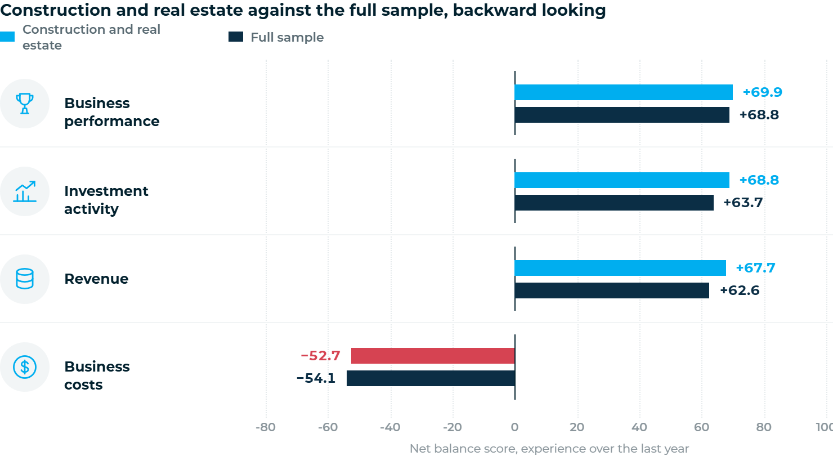
MAIN INDICATORS
Ahead of the sample on key measures last year
OVERALL INDEX SCORE
+5.1
ahead of the global average on both revenue and investment
−52.7
cost score, 1.4 points better than the global average
moore-global.com
03

Slide 4
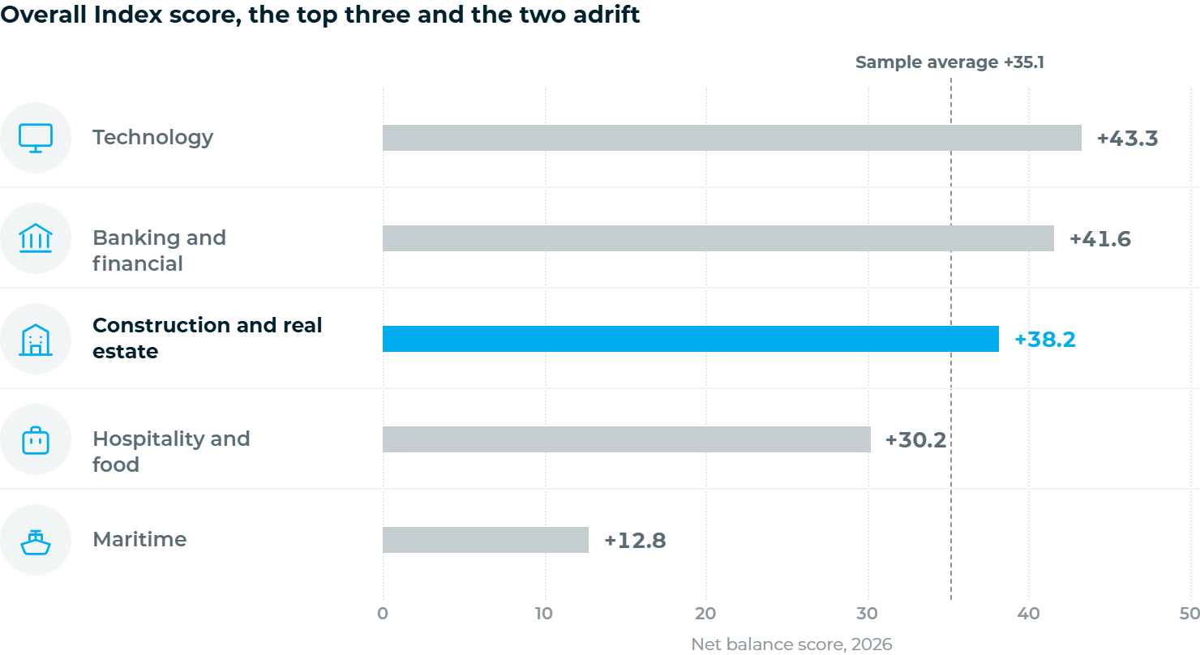
REAL ESTATE v GLOBAL AVERAGE
Third of 15 main sectors in the world economy
GAP TO THE TOP
5.1
points
Technology leads league table on +43.3; banking sits between on +41.6
+35.1
full-sample average, 3.1 points below this sector
Top 5
on the business performance pillar; 3rd on investment
moore-global.com
04

Slide 5
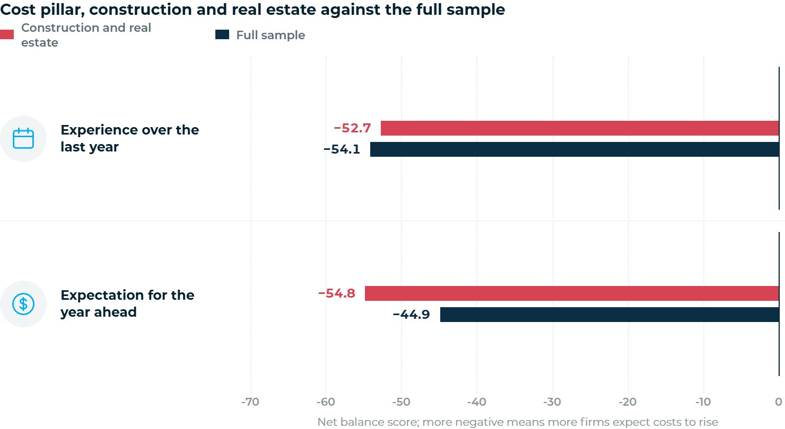
THE COST SQUEEZE
Real estate more worried about costs this year than other main industries
WHAT WILL PUSH COSTS UP
01
Interest rates and financing costs
02
Raw material costs
03
Utilities and fuel costs
68.8%
expect costs to rise next year; 14.0% expect a fall
9.9
points worse than the sample on expected costs
moore-global.com
05

Slide 6
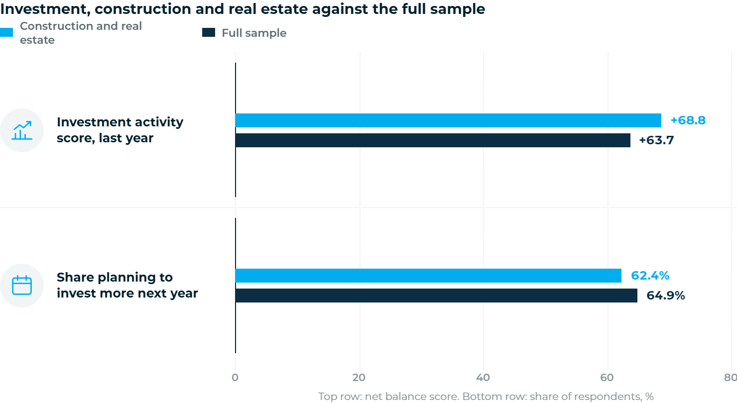
INVESTMENT AND OUTLOOK
Still investing, but more cautious than the global average
INVESTMENT ACTIVITY, LAST YEAR
+68.8
3rd of 15
Behind technology and banking; 5.1 points above the global average
62.4%
plan to raise investment levels
64.9%
of the full sample plan the same: 12.0% expect to scale back
moore-global.com
06

Slide 7
THE TAKEAWAY
Three moves for
real estate and construction firms
Lock in finance before it becomes more expensive
1st
01
Interest rates and financing costs are the first-named driver of rising costs, in a sector that relies on external finance. Fix terms where possible and stress-test projects against higher rates.
financing costs lead the cost drivers
02
Assume higher material and energy costs in every bid
68.8%
Raw materials and utilities sit second and third among the drivers. With 68.8% expecting costs to rise, contracts written on last year’s inputs will not hold their margin.
expect costs to rise again next year
03
Keep investing but be selective
62.4%
Nearly two in three firms still plan to invest more, and the sector ranks third on the investment pillar. Direct it at productivity and pre-let demand rather than speculative volume.
plan to raise investment next year
moore-global.com
07

Slide 8
Helping you thrive in a changing world
At Moore, our purpose is to help people thrive – our clients, our people, and the communities they live and work in.
We’re a global accounting and advisory family with 37,054 people in 568 offices across 119 countries, connecting and
collaborating to take care of your needs – local, national and international.
We’ll be here for you whenever you need us – to help you see through the maze of information, to guide you in your
decisions and to make sure you take advantage of every opportunity. To help you thrive in a changing world.
Moore Global Network Limited is a company incorporated in accordance with the laws of England and provides no audit or other professional services to clients. Such services are provided solely by member firms of MGNL in their respective geographic areas. MGNL and its member firms are legally distinct and separate entities owned and managed in each location

